Slide 1
Routing & Navigation
AKHILA P NAIR

Slide 2
Home
Product List
http://localhost:3000/welcome
http://localhost:3000/product
WelcomeComponent/ ProductListComponent

Slide 3
Routing
Set base tag in index.html
Configure routes
Tying routes to actions
Placing the views

Slide 4
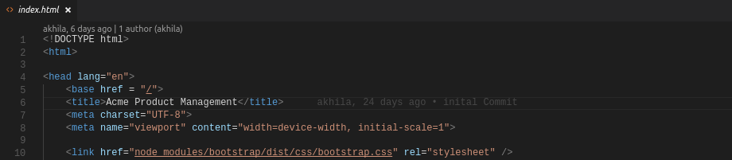
Set base tag in index.html
If you used the angular-cli to create the project you're working with, it will automatically add this in the head tag. If it's not there, add it:

Slide 5
Configure routes
Import RouterModule in app.module.ts
Add RouterModule to the @NgModule.imports array and configure it with the routes in one step by calling RouterModule.forRoot()
RouterModule.forRoot([{ path: welcome, component: WelcomeComponent } ])

Slide 6
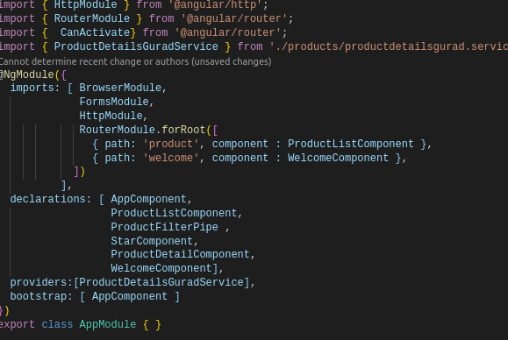

Slide 7
RouterModule.forRoot([
{ path: 'product', component : ProductListComponent },
{ path: 'welcome', component : WelcomeComponent },
])
A typical Angular Route has two properties:
path: a string that matches the URL in the browser address bar.
component: the component that the router should create when navigating to this route.

Slide 8
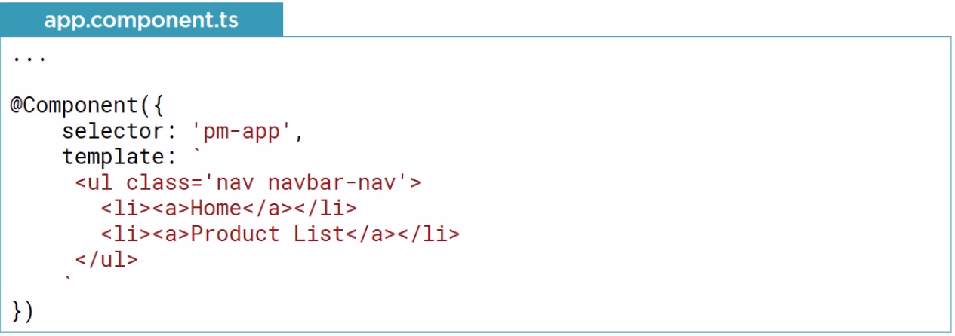
Tying routes to actions
Navigation

Slide 9
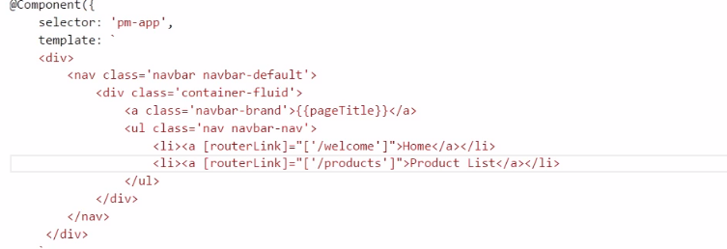
Tying routes to actions
RouterLink
RouterLinkActive

Slide 10
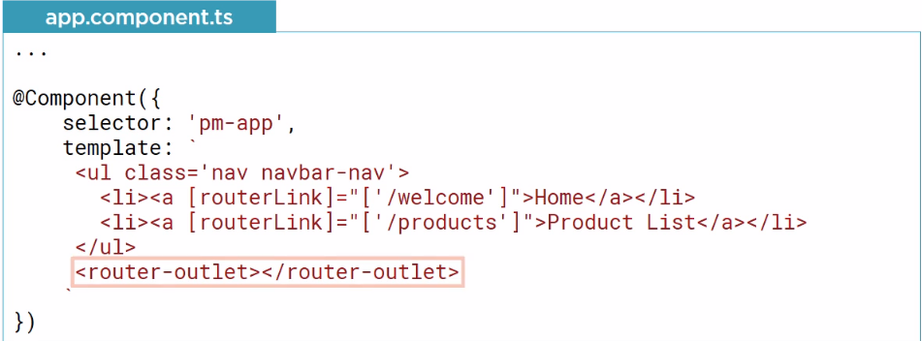
Placing the views
<router-outlet></router-outlet>

Slide 11
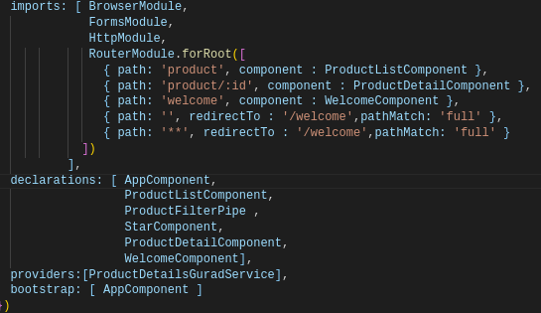
Passing Parameter to a Route

Slide 12
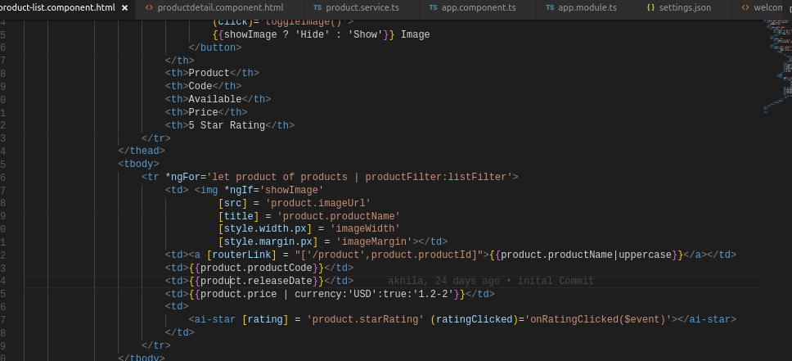

Slide 13
